Slide 1
Accidental Drug Death from 2012-2018
Group 4
Department of Information Technology, California State University
Los Angeles
Miguel Guzman, Erick Gomez, Jacob Zubiate, Mauricio Ruvalcaba, Steven Flores
Notes:
Idea is not the most unique but is one that can provide an example on how much drugs is affecting people by seeing the increase of people that die due to overdose, as well as trying to identify the trend of those drugs, which one is being use the most and the likes.
Provide a git hub link with the location of all the files from this project.

Slide 2
Abstract
The increase of drugs has made it possible for people to have access to it more easily than before. The cases of drug abuse have escalated in a more drastic manner throughout the years. This has led to people to abuse them more constantly and seek them more frequently, causing an increase of what they can handle. This leads to unintentional drug overdose death, which has been claiming many people lives. The data obtain on governmental database would allow us to analyze and understand the type of drugs that are more being use as well which ones are being abuse the most. As well which one has a higher death count.

Slide 3
Data Size and Information
Data used for this project was acquire from Data.gov
Data name: Collection of Accidental Drug Related deaths 2012-2018
Data size: 1.02MB
Data Source: https://catalog.data.gov/dataset/accidental-drug-related-deaths-january-2012-sept-2015
GitHub: https://github.com/GianV77/CIS3200Project.git
Azure Gallery: https://gallery.cortanaintelligence.com/Experiment/Drug-overdose-death-2012-18
https://gallery.cortanaintelligence.com/Experiment/Accidental-Drug-Related-Deaths
Kibana Dashboard: https://d39a26931e4747399a5bee5f8fd0c1b5.us-west-1.aws.found.io:9243/goto/07a82e393e0424c32bd986400708ccb8

Slide 4
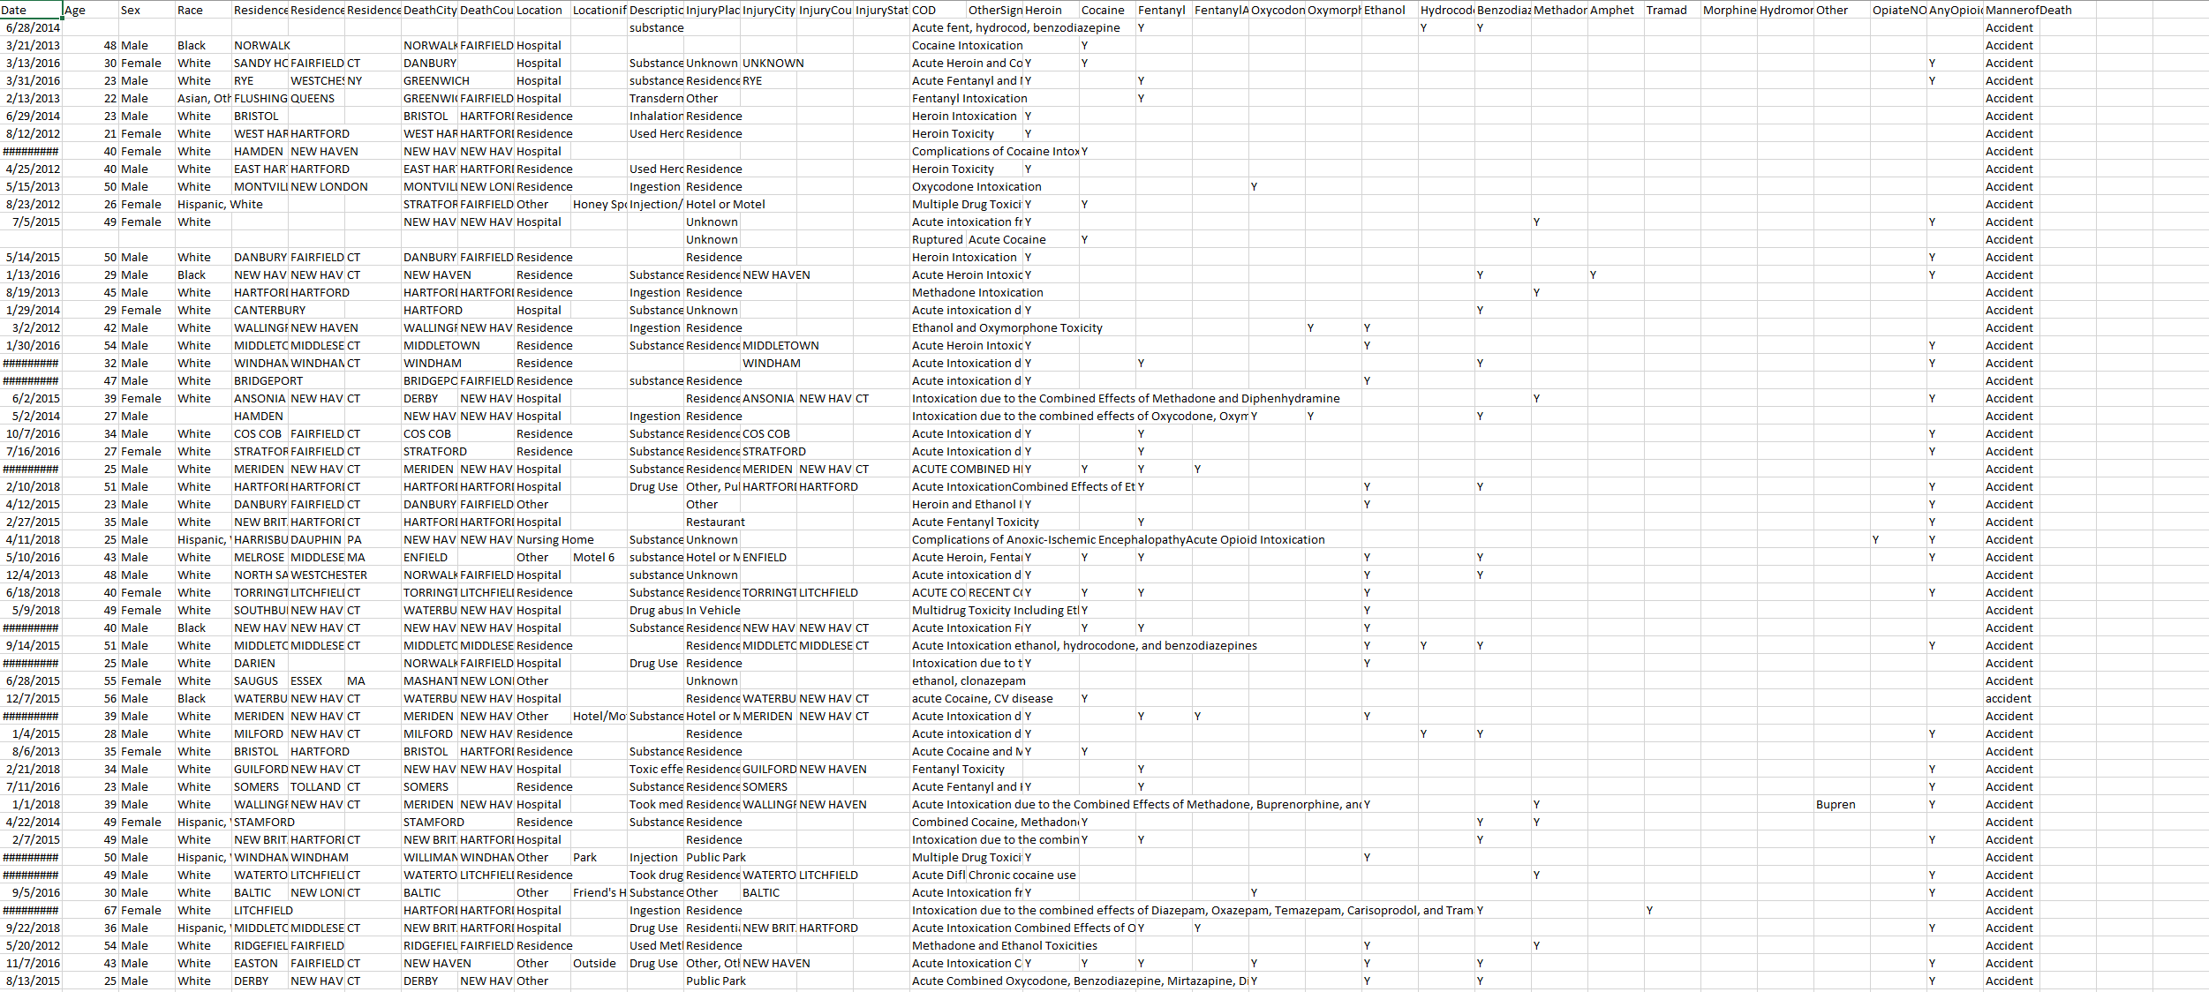

Slide 5

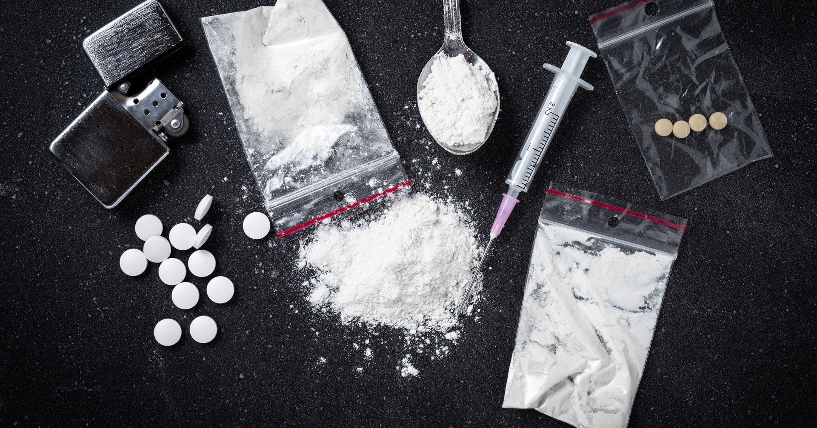

Introduction
The objective of the study is to analyze, understand, and predict the type of drugs that cause and will cause the most accidental deaths by making use of the data collected from the state of Connecticut

Slide 6



Main Work
Using Elastic Cloud and Kibana we created visualization of the content of the data, that allow us to see and compare some of the important information that is being convey. The data contain information about the people that die due to drug overdhose.

Slide 7

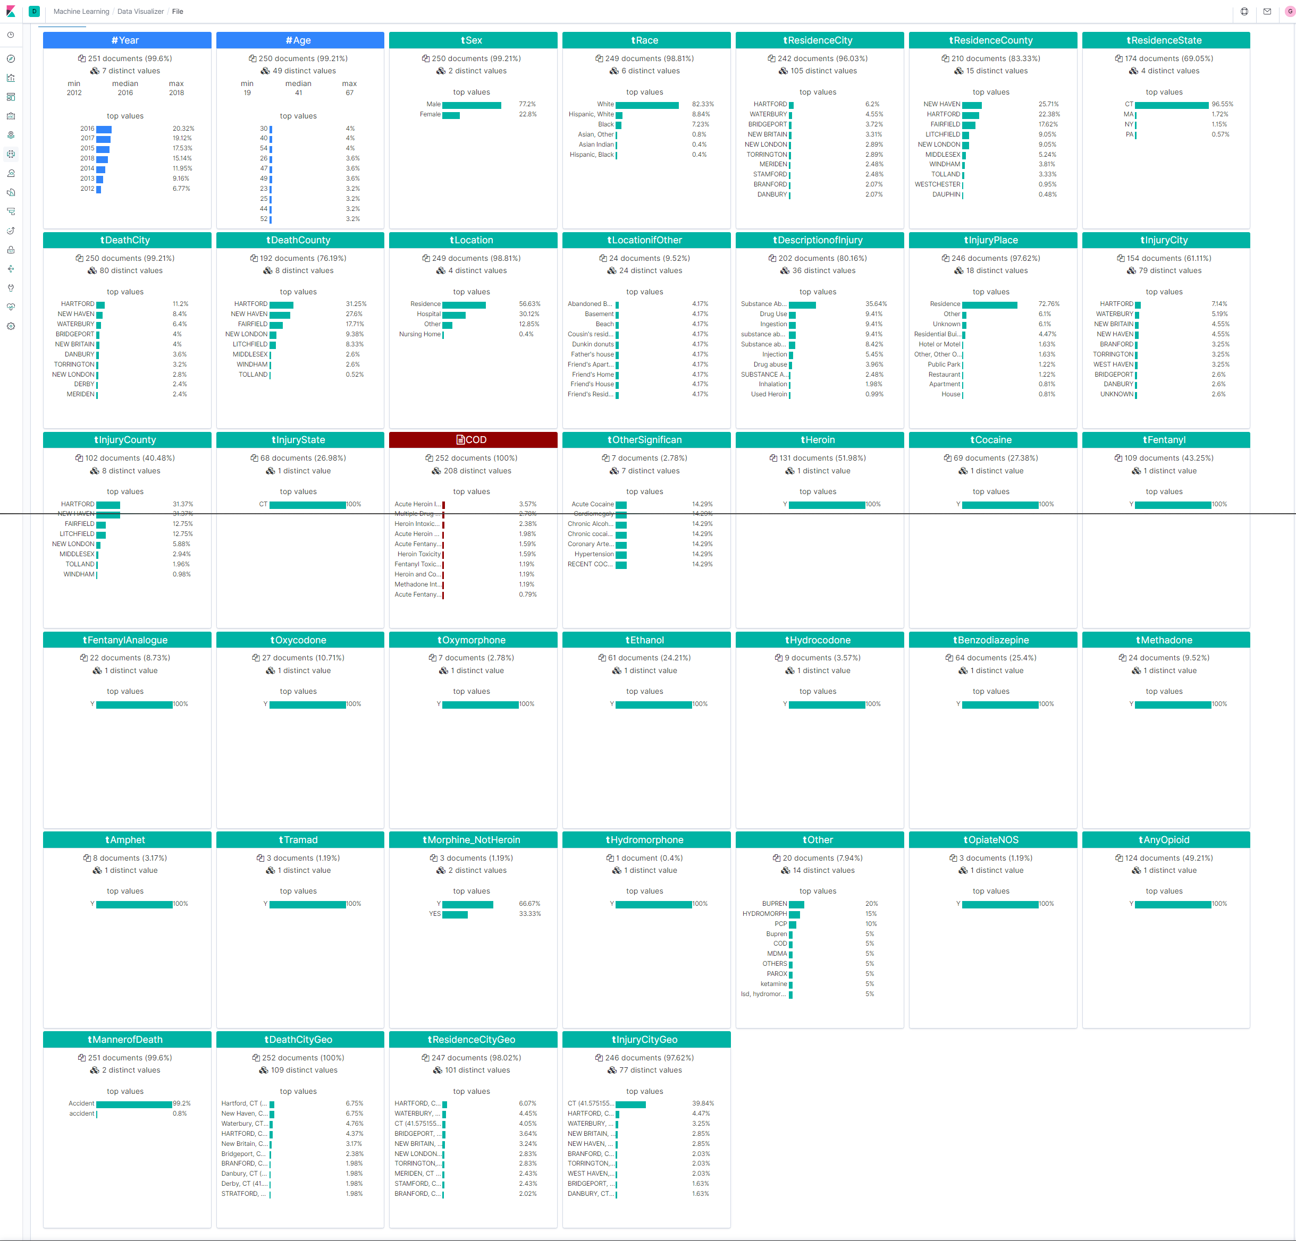
Elastic/Kibana Implementation
Using elastic we can visualize graphs of data in a visual manner which allow to understand the information that is collected in a more simplistic manner.

Slide 8
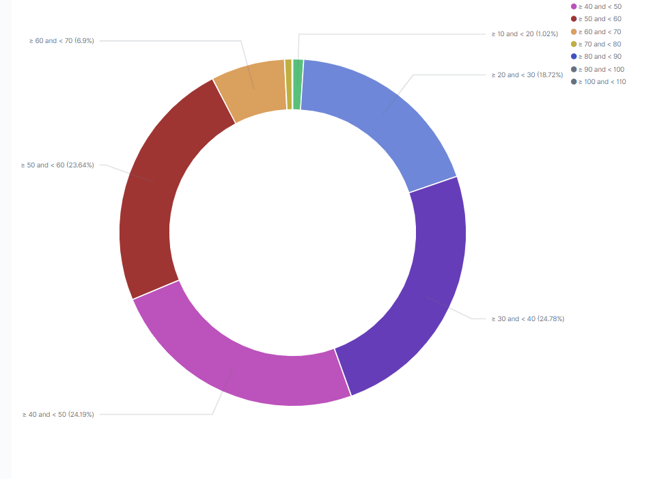
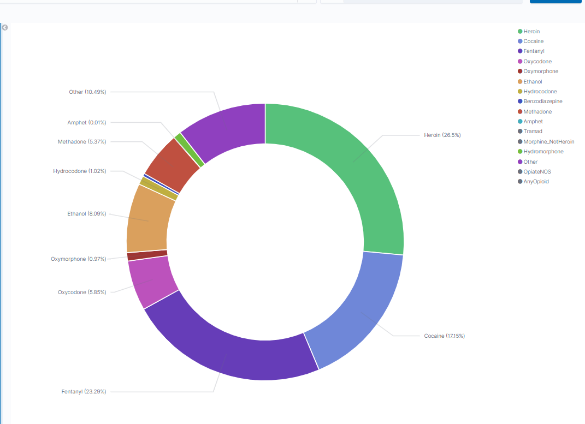
Visuals
Drug usage percentage usage
Average age range of overdose deaths

Slide 9
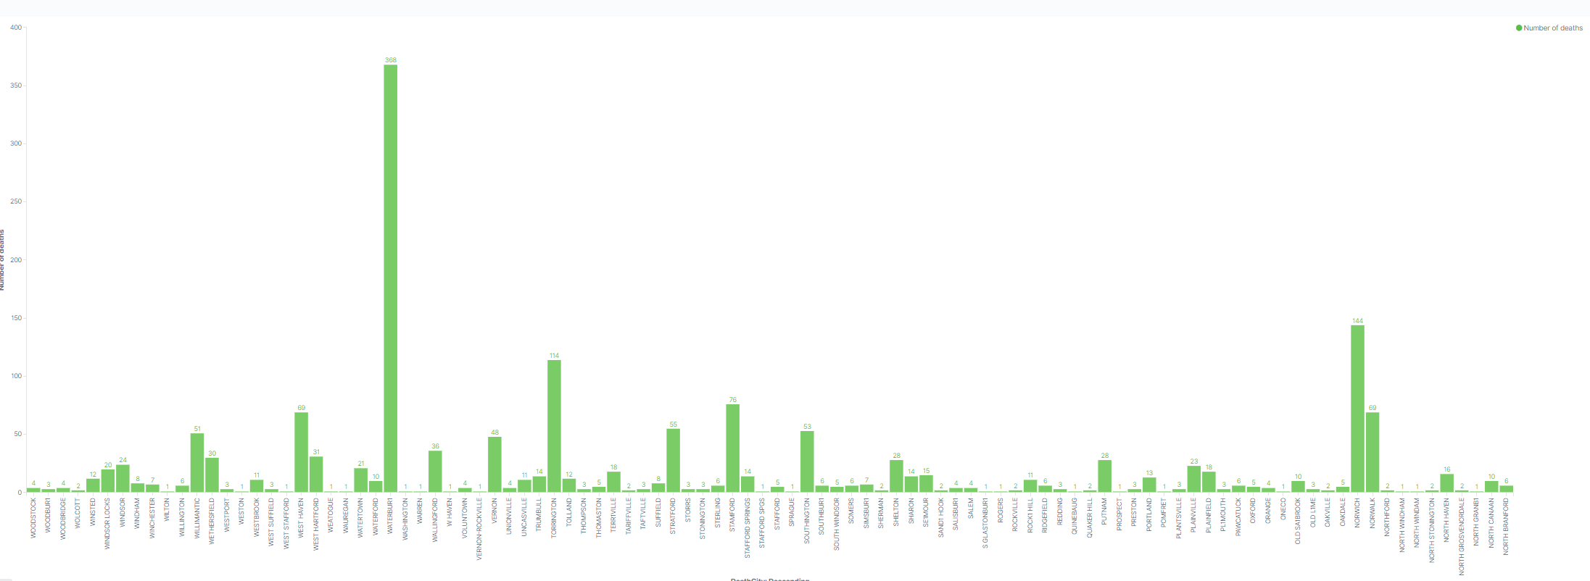
Visuals
Number of death per city on Connecticut

Slide 10
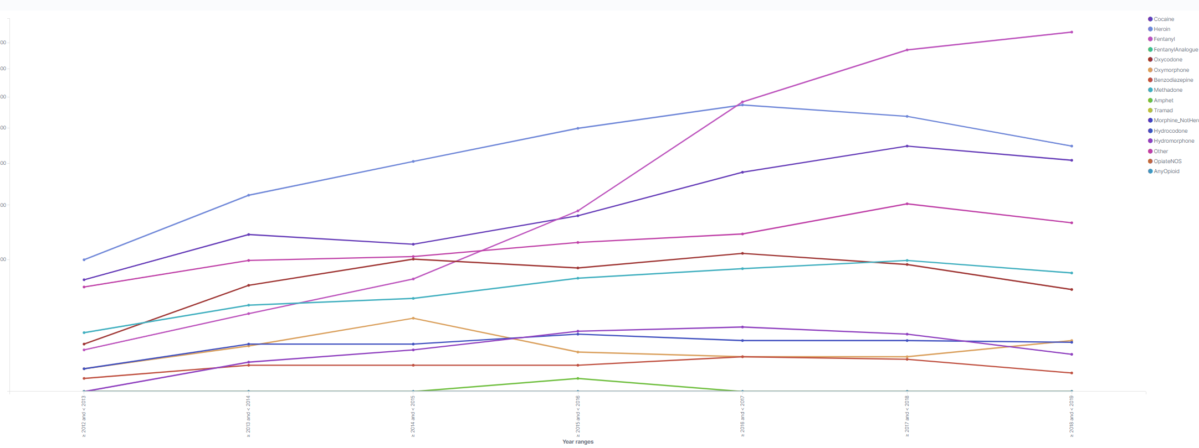
Visuals
Increase and decrease of drugs usage from 2012-2018

Slide 11
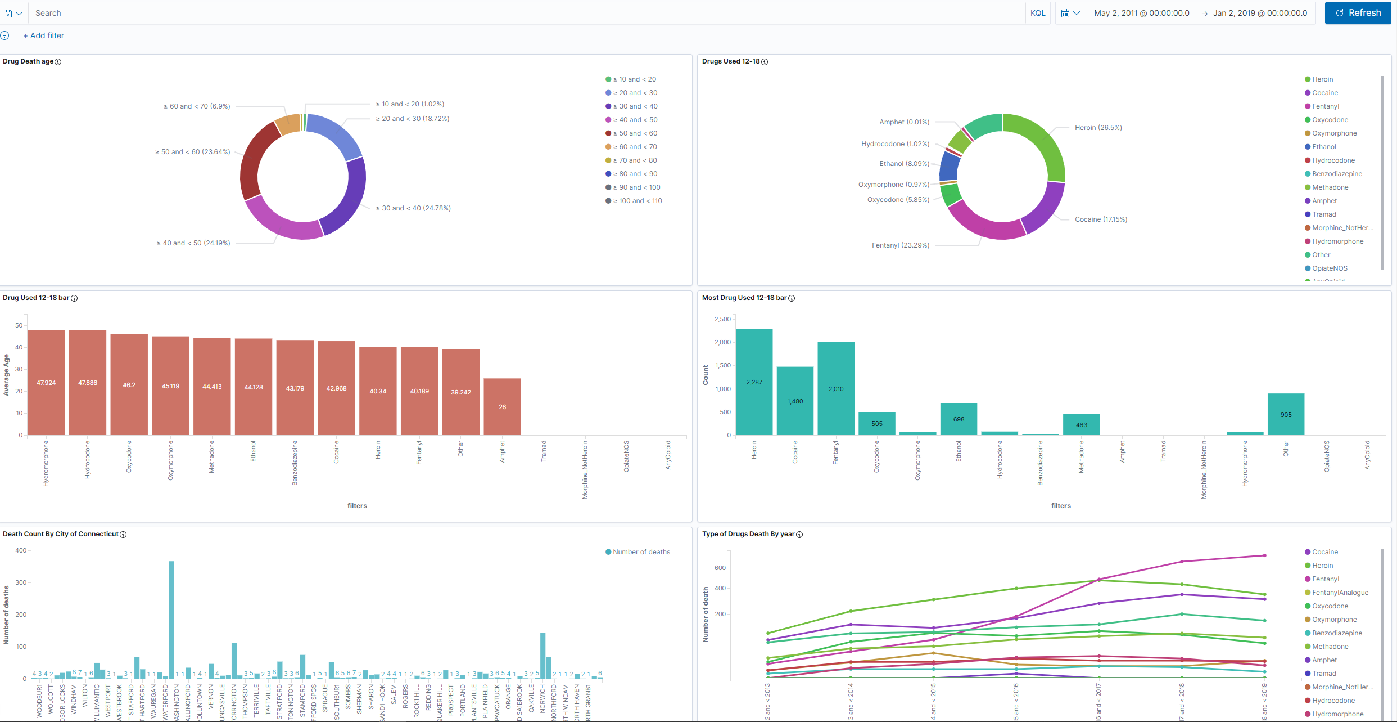
Dashboard

Slide 12
Azure Implementations
In Azure we made used of Linear Regression which is type of regression analysis where the number of independent variables is one and there is a linear relationship between the independent and dependent variable. Decision tree model is very good at handling tabular data with numerical features, or categorical features with fewer than hundreds of categories.
With it apply we scored the dataset as get the values that would represent the prediction of future. As it takes the frequency of the data list rows with similar score and indicates the likelihood of it being part of the same type.

Slide 13
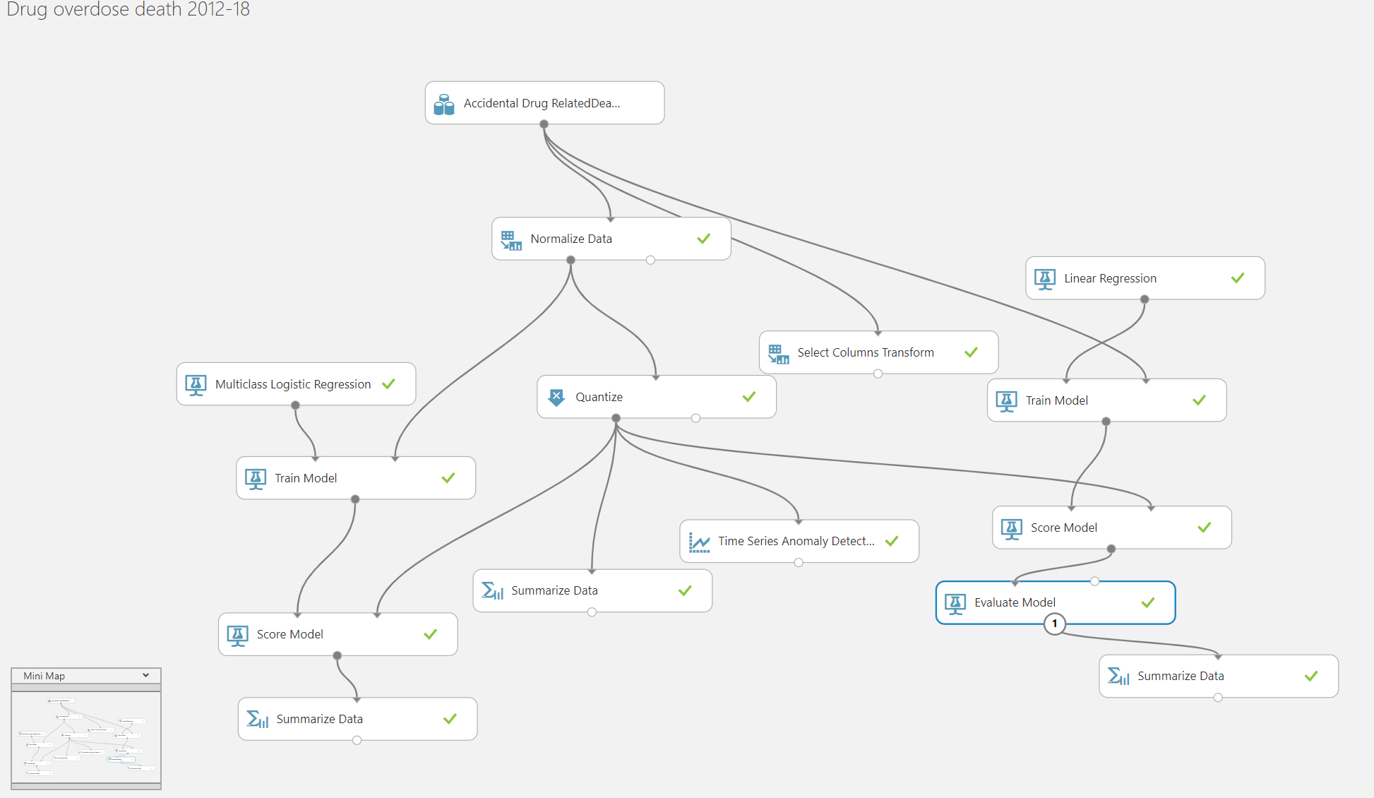

Slide 14
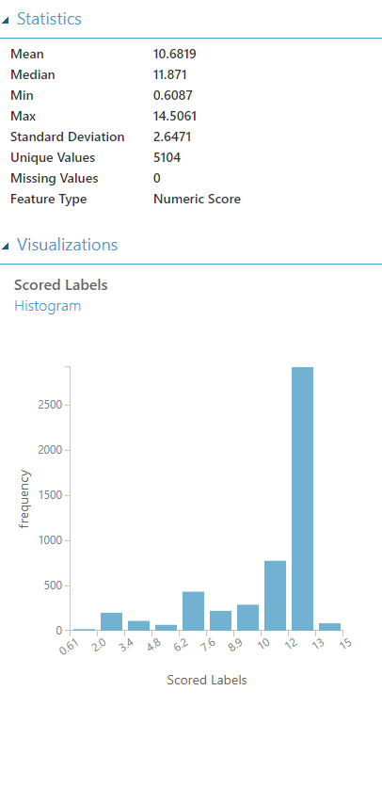

Slide 15
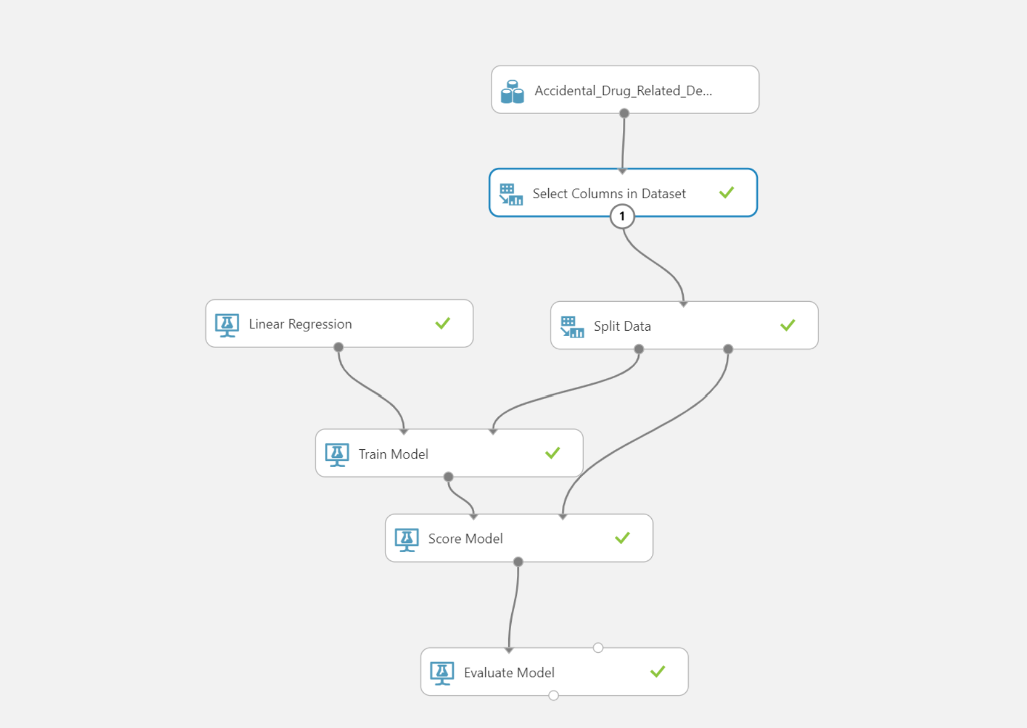

Slide 16
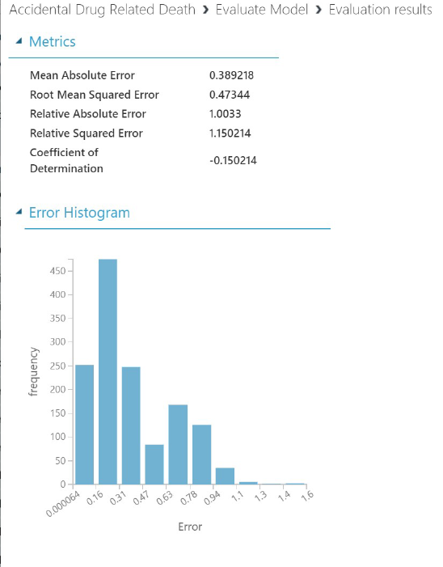
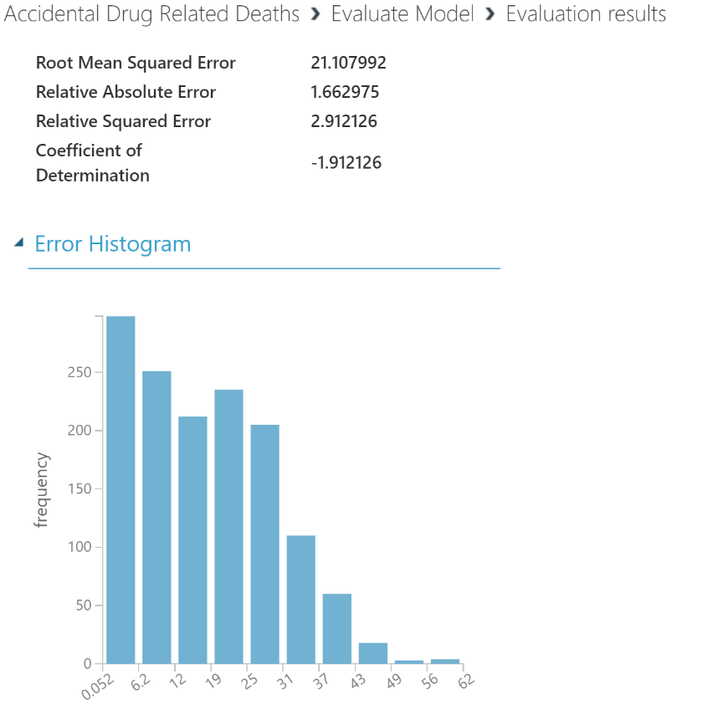

Slide 17
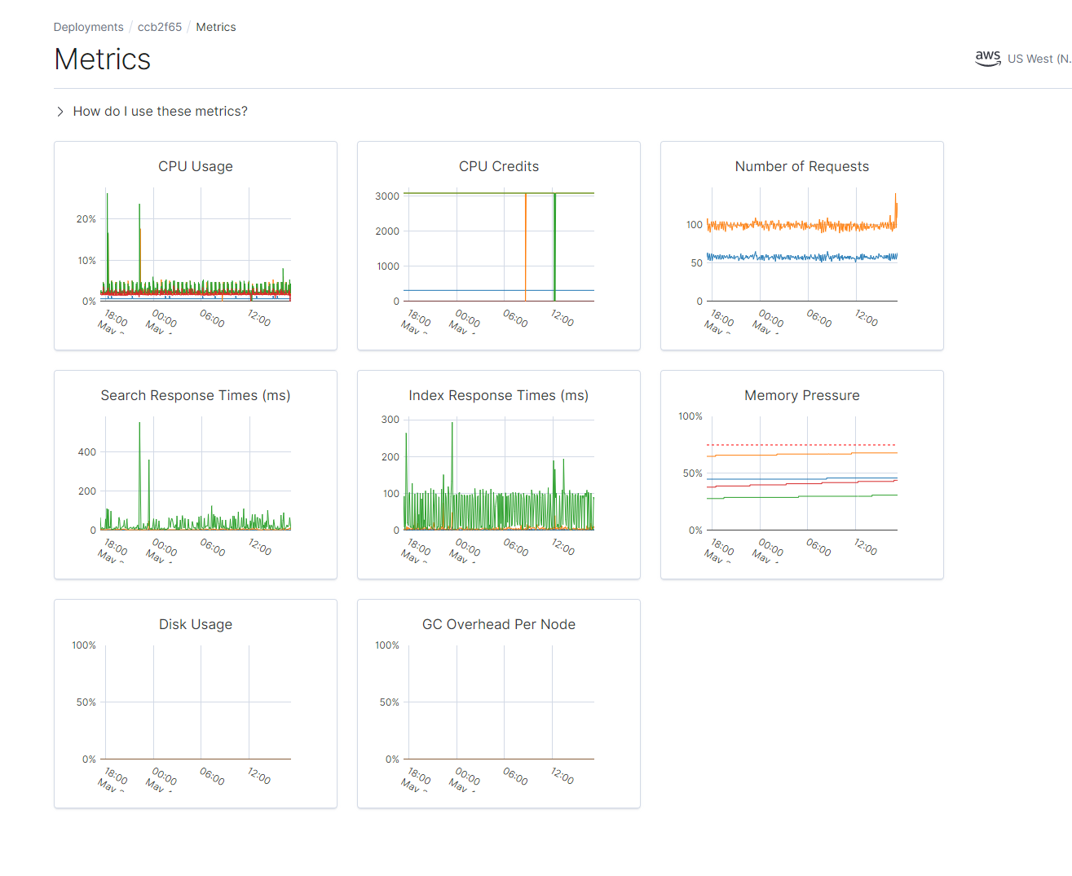
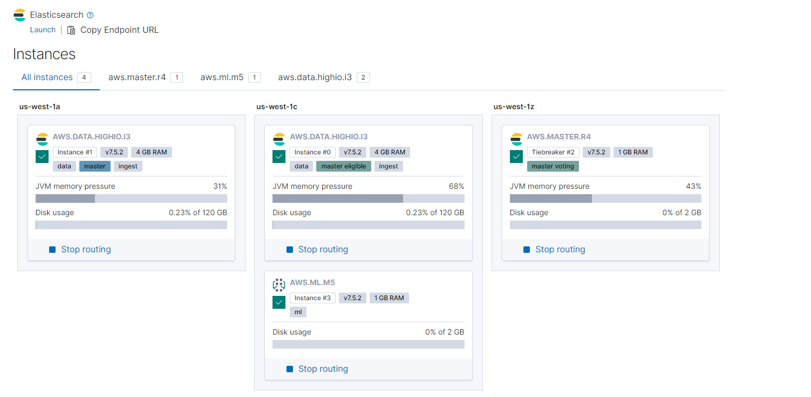

Slide 18
Kibana Dashboard
https://d39a26931e4747399a5bee5f8fd0c1b5.us-west-1.aws.found.io:9243/app/kibana#/dashboard/bb739dd0-8a73-11ea-8a60-832e84ee957d?_g=()&_a=(description:'',filters:!(),fullScreenMode:!f,options:(hidePanelTitles:!f,useMargins:!t),panels:!((embeddableConfig:(title:'Drug+Used+12-18+bar',vis:(legendOpen:!f)),gridData:(h:15,i:ea4471ac-a988-4c62-91cf-0f9e249b5b7d,w:24,x:0,y:15),id:'1ea8b970-8732-11ea-8a60-832e84ee957d',panelIndex:ea4471ac-a988-4c62-91cf-0f9e249b5b7d,title:'Drug+Used+12-18+bar',type:visualization,version:'7.5.2'),(embeddableConfig:(),gridData:(h:15,i:aefdfcb9-c063-40a6-bae2-8c11048eefa8,w:24,x:24,y:0),id:'042cbed0-8731-11ea-8a60-832e84ee957d',panelIndex:aefdfcb9-c063-40a6-bae2-8c11048eefa8,type:visualization,version:'7.5.2'),(embeddableConfig:(),gridData:(h:15,i:b048a106-48f0-460a-9ab0-b33821b32eba,w:24,x:0,y:30),id:'2a9c6010-8a66-11ea-8a60-832e84ee957d',panelIndex:b048a106-48f0-460a-9ab0-b33821b32eba,type:visualization,version:'7.5.2'),(embeddableConfig:(legendOpen:!t,vis:(legendOpen:!f)),gridData:(h:15,i:'7e5c243f-92f1-45f8-9b35-2545b079bb27',w:24,x:24,y:15),id:'30dea8d0-8a65-11ea-8a60-832e84ee957d',panelIndex:'7e5c243f-92f1-45f8-9b35-2545b079bb27',type:visualization,version:'7.5.2'),(embeddableConfig:(),gridData:(h:15,i:'81fae6fd-8227-4fa6-814c-dcf0f5893987',w:24,x:0,y:45),id:'9ae0f3c0-8a72-11ea-8a60-832e84ee957d',panelIndex:'81fae6fd-8227-4fa6-814c-dcf0f5893987',type:visualization,version:'7.5.2'),(embeddableConfig:(),gridData:(h:15,i:'4d39c1d0-5001-4171-ace5-385a1ebcd259',w:24,x:24,y:30),id:'4fd47980-8a6b-11ea-8a60-832e84ee957d',panelIndex:'4d39c1d0-5001-4171-ace5-385a1ebcd259',type:visualization,version:'7.5.2'),(embeddableConfig:(),gridData:(h:15,i:'15907da2-b053-4558-bfcb-e44ec7ce528d',w:24,x:0,y:0),id:e4f63990-8a75-11ea-8a60-832e84ee957d,panelIndex:'15907da2-b053-4558-bfcb-e44ec7ce528d',type:visualization,version:'7.5.2')),query:(language:kuery,query:''),timeRestore:!f,title:'Drugs+Death+Overdose+Connecticut+2012-18',viewMode:view)

